Slide 1
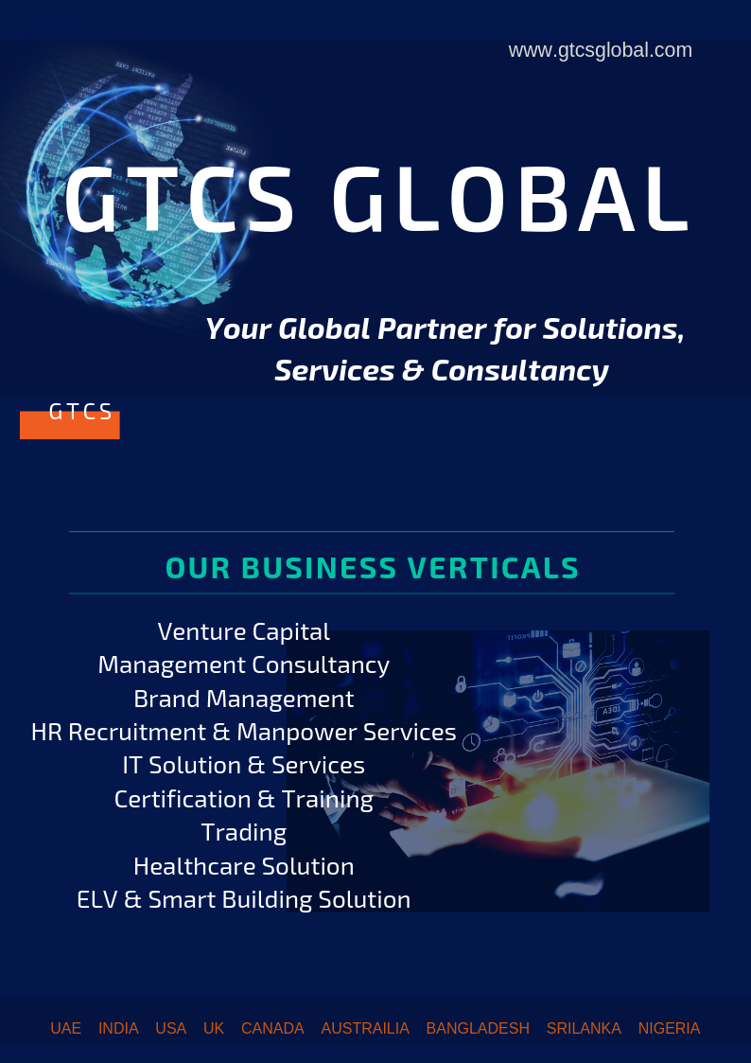

Slide 2

Our Strengths
A Professionally Managed Institution
Solution, Services & Consultancy House
Cost Effective & Value for Money
Customer Centric & Flexible
World Wide Network
Global Experience
Our Consultative Approach
Significant Management & Technical Expertise
Global Sales & Solution Delivery Model
Partnerships with Leading Organizations & Solution Providers

Slide 3

Business Verticals
Venture Capital
FDI, Free Zone, SEZ & Smart City Consultancy
Management Consultancy
Brand Management
HR, Recruitment & Manpower Services
Trading
Certification & Training
Healthcare
Real Estate
ELV & Smart Building Solution
IT Solution & Services

Slide 4

Venture Capital
Seed Funding
Series A, B & C Funding
Project Funding

Slide 5
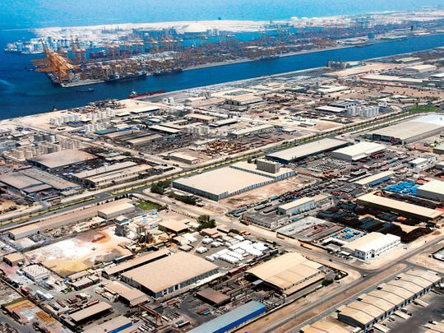


FDI, FREE ZONE, SEZ & SMART CITY CONSULTANCY
Strategy & Organization
FDI Attraction & Lead Generation
Brand Management, Marketing & Promotion
Facilitation & Investor Support
Aftercare & Retention Support
Evaluation & Bench Marking
Policy Advocacy
Talent Management, Training & Development
Smart City Consultancy, Framework & Solutions

Slide 6
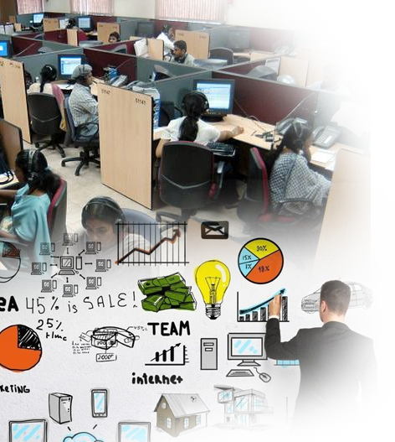
Management Consultancy
Strategic Planning
Organization Efficiency Management
Revenue & Market Share Growth
Cost Optimization & Control
KPI Definition & Monitoring
Financial Consultancy & Management
HR Consultancy & Manpower Optimization
Business Incorporation Support & Liaison Services
Legal and Statutory Consultancy & Support
Business Transformation & Turnaround
Project Management
Business Process Reengineering (BPR)
Business Process Outsourcing (BPO)
Automation & IT Consultancy
SEZ, Free Zone & Smart City Consultancy
M&A Advisory

Slide 7

Brand Management
Brand Strategy
Brand Development
Brand Management
Media & PR Management
Digital Marketing
Social Media Marketing
Brand Design
Marketing Collateral & Graphic Design
Website & Web Portal Design

Slide 8

HR, Recruitment & Manpower Services
Recruitment Services
Executive Search & Placement
Head Hunting
Technical Recruitment
Non Technical Recruitment
Managed Resources
Managed IT & Engineering Resources
Manpower Deployment
Project / Bulk Recruitment
HR & Payroll Solution
HR Consultancy

Slide 9

Readily Available Profiles / Resources
> Project Director, Project Managers, Architects, Managers
> Sales, Marketing, HR, Accounts, Finance, Accounts, Operations,
Administration, Back Office Professionals
> IT Resources
- ERP Consultants (Functional & Technical) SAP, Microsoft, Oracle
- Data Warehousing, Business Intelligence, AI Consultants, DBAs
- IT Manager, Project Manager, Technical Lead, Network Engineers, Developers
(Java, .Net, ASP, VB), Designers, Animation, Gaming, Help Desk
> Telecom Resources, Environment Resources
> Engineering Resources
- HVAC, Civil, Electrical, Mechanical, Chemical, Petrochemical
- Draftsman, Engineers, Architects

Slide 10
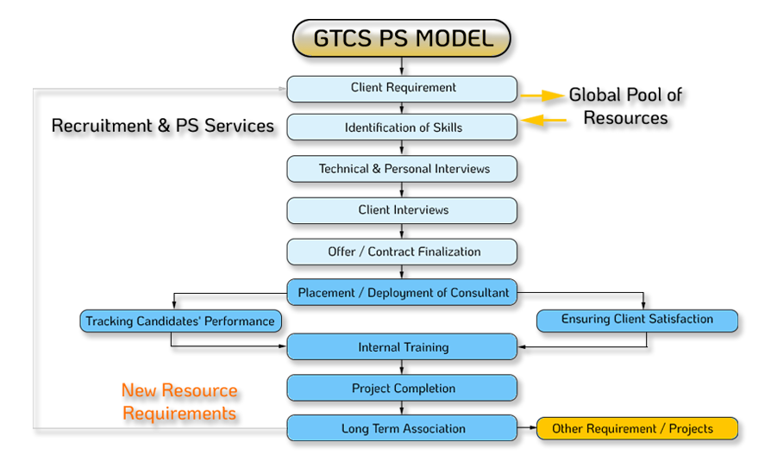

Slide 11

Certification & Training
Quality Certification & Training
Environmental Certification & Training
Health & Safety Certification & Training
Soft Skills Training (Winning Attitude, Effective Communication, Negotiation Skills, Positive Attitude, Interpersonal Skills, Time Management, Team Work, Problem Solving Skills)
Sales, Marketing, Digital Marketing, Brand Development, Brand Management Training
Customer Service, Customer Relationship Management Training
Project Management Training
Strategic Planning, Management Concepts Training

Slide 12

Healthcare
Healthcare
Hospital Management System
Recruitment of Doctors, Nurses, Paramedic & Healthcare Staff
Healthcare Platform for Integrated Healthcare Services

Slide 13

ELV & Smart Building Solution
ELV & Smart Building Solution Design, Value Engineering and Implementation for Modern Commercial & Residential Buildings (Shopping Malls, Hotels, Offices, Airports, Sea Ports, Railways, Metro & Bus Stations, Residential Complex, Factories, Warehouses, Highways etc.)
IT Security & Surveillance Solution (CCTV, Access Control, T&A)
Structured Cabling (Voice & Data)
Audio Visual Solution (Display Signage, Video Wall, Kiosk, Public Address & Background Music System)
IP Telephony, Communication & Connectivity Solution
Mobile Radio & Wireless Communication
Parking Management & Ticketing Solution
IBMS & BMS, ATMS, HTMS
Fire Fighting & Emergency Lighting Solution

Slide 14

IT Solution & Services
Global Technologies & Consulting Services is the IT arm of the group and provides below solution & services.
Software Solution & Services
ERP Solution, CRM Solution, Spend Management, School & College Management Solution, Hospital Management Solution, Fleet Management & Vehicle Tracking Solution, Air & Sea Port Management Solution, Bespoke Software, Web Based Application & Mobile Application Development, System Integration, DBA Services
IT Infrastructure Solution & Services
IT Infrastructure Solution, Server & Storage Consolidation, Structured Cabling & Networking Solution, Security & Surveillance Solution, IP Telephony & Call Center Solution, Centralized Backup & DR Solution
IT Consultancy

Slide 15
OUR SERVICES
Management Consultancy
Business Incorporation Services (Free Zone & Mainland)
Liaison Services (Government & Non-Government)
Advisory and M&A Services
Project Planning, Negotiation & Management
Strategy, Revenue & Market Share Growth Support
Funding, Debt Restructuring, Financial & Cost Consultancy
Legal & Statutory Consultancy and Support
HR Consultancy, Recruitment & Manpower Services
IT Solutions & Services
Certification, Training & Skill Development
Advertising & Brand Management
Event Management
BPO Services
Survey & Analytics
M&A Advisory

Slide 16

CONTACT US
GTCS GLOBAL Global Technologies & Consultancy Services
GTCS GLOBAL VENTURES
GTCS FZ LLC Dubai, Sharjah, RAK, UAE
Website: www.gtcsglobal.com
Enquiries: enquiry@gtcsglobal.com gtcsglobal@gmail.com
Hotline: +971-50-5828389, +971-55-5019678 (UAE) +91-7073063923 (India)

Slide 17

www.gtcsglobal.com

